Slide 1
SPEECH TO TEXT TOOL

Slide 2
ABSTRACT
Speech recognition is one of the fastest-growing engineering technologies. It has several applications in different areas, and provides many potential benefits a lot of people are unable to communicate due to language barriers.
We aim to reduce this barrier via our project, which was designed and developed to achieve systems in particular cases to provide significant help so people can share information by operating a computer using voice input.
This project keeps that factor in mind, and an effort is made to ensure our project is able to recognize speech and convert input audio into text; it also enables a user to perform file operations like Save, Open, or Exit from voice-only input.
We design a system that can recognize the human voice as well as audio clips, and translate between English.
The output is in text form, and we provide options to convert audio from one language. Going forward, we expect to add functionality that provides dictionary meanings for English words.
Neural machine translation is the primary algorithm used in the industry to perform machine translation.
This work on speech recognition starts with an introduction to the technology and the applications used in different sectors part of the report is based on software developments in speech recognition.

Slide 3
SCOPE
This project keeps that factor in mind, and an effort is made to ensure our project is able to recognize speech and convert input audio into text; it also enables a user to perform file operations like Save, Open, or Exit from voice-only input.
We design a system that can recognize the human voice as well as audio clips, and translate between English.
The output is in text form, and we provide options to convert audio from one language. Going forward, we expect to add functionality that provides dictionary meanings for English words.

Slide 4
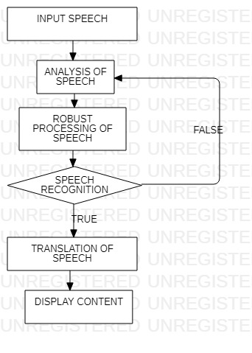
FLOW CHART

Slide 5
REFERENCES
[1] Mrinalini Ket al: Hindi-English Speech-to-Speech Translation System for Travel Expressions, 2015 International Conference On Computation Of Power, Energy, Information And Communication.
[2] Development and Application of Multilingual Speech Translation Satoshi Nakamura', Spoken Language Communication Research Group Project, National Institute of Information and Communications Technology, Japan.
[3] Speech-to-Speech Translation: A Review, Mahak Dureja Department of CSE The NorthCap University, Gurgaon Sumanlata Gautam Department of CSE The NorthCap University, Gurgaon. International Journal of Computer Applications (0975 – 8887) Volume 129 – No.13, November2015.
[4] Sequence-to-Sequence Models for Emphasis Speech Translation. Quoc Truong Do,Skriani Sakti; Sakriani Sakti; Satoshi Nakamura, 2018 IEEE/ACM.
[5] Olabe, J. C.; Santos, A.; Martinez, R.; Munoz, E.; Martinez, M.; Quilis, A.; Bernstein, J., “Real time text-to speech conversion system for spanish," Acoustics, Speech, and Signal Processing, IEEE International Conference on ICASSP '84. , vol.9, no., pp.85,87, Mar 1984.
[6] Kavaler, R. et al., “A Dynamic Time Warp Integrated Circuit for a 1000-Word Recognition System”, IEEE Journal of Solid-State Circuits, vol SC-22, NO 1, February 1987, pp 3-14.
[7] Aggarwal, R. K. and Dave, M., “Acoustic modeling problem for automatic speech recognition system: advances and refinements (Part II)”, International Journal of Speech Technology (2011) 14:309–320.
[8] Ostendorf, M., Digalakis, V., & Kimball, O. A. (1996). “From HMM’s to segment models: a unified view of stochastic modeling for speech recognition”. IEEE Transactions on Speech and Audio Processing, 4(5), 360– 378.
[9] Yasuhisa Fujii, Y., Yamamoto, K., Nakagawa, S., “AUTOMATIC SPEECH RECOGNITION USING HIDDEN CONDITIONAL NEURAL FIELDS”, ICASSP 2011: P-5036-5039.
[10] Mohamed, A. R., Dahl, G. E., and Hinton, G., “Acoustic Modelling using Deep Belief Networks”, submitted to IEEE TRANS. On audio, speech, and language processing, 2010.

